Slide 1


HopeLink: Empowering Donations for a Better Tomorrow
An Online Fundraising and Donations Portal
Presented by:
Rashed Hassan Siam
MSc Student
Roll: CSE-FH-2343
Md. Shakhawath Hossain Nur
MSc Student
Roll: CSE-FH-2323
Presented to:
Dr. Md. Mamun-Or-Rashid
Professor
Department of Computer
Science and Engineering
University of Dhaka

Slide 2
Presentation Outline
Introduction
Proposed Solution and its Features
Umbrella and Web Engineering Framework Activities
Communication
Planning
Modeling
Use Cases
Web Application Architecture Framework (WAAF) Matrix
Interaction Design
Information Design

Slide 3
Introduction
Problem Statement:
Many underdeveloped regions of our country face difficulties in raising funds and managing donations.
NGOs struggle to connect with potential donors and efficiently track their requests for aid.
Objective:
To create a user-friendly platform connecting NGOs and donors, with a clear focus on secured donations, ease of use, and real-time updates.

Slide 4
Proposed Solution
HopeLink Platform:
A web-based portal that:
Allows NGOs to request donations for specific causes, track donations, and connect with donors.
Allows donors to donate for the requests raised by the NGOs and track their donations.
Allows admins to manage the requests and oversee the transparency of all the transactions.

Slide 5
Proposed Features
Key Features:
Real-time updates on donation requests.
Multiple payment methods.
Admin dashboard for managing and tracking NGO requests.
Notifications for donors and NGOs regarding ongoing donation drives.
Legitimacy of NGOs by verifying their uploaded certification documents.

Slide 6
Umbrella Activities
Risk Management:
Addressing heterogenous donation methods, service availability, and transaction integrity.
Quality Assurance:
Continuous testing for seamless payment processing, user authentication, and data handling.
Change Management:
Tracking the changes after each increment and managing their effects.
Project Management:
Tracking and monitoring progress of each increment.

Slide 7
Web Engineering Framework Activities
Communication: Survey NGOs, donors, and admins to gather specific needs.
Planning: Identify the scope, functionalities, potential risks and finally generate a tentative schedule for deployment.
Modeling: Design interface and navigations for NGOs, donors, and admins.
Construction: Build both the frontend and backend of the platform using a modern web development stack.
Deployment: Release the increment and gather feedback from users.

Slide 8
Communication Phase: Questionnaire
NGO Questionnaire:
What specific fields should be included in donation requests?
What type of documents will they upload for verification?
Donor Questionnaire:
Which donation methods do they prefer?
How important is real-time tracking for them?
Admin Questionnaire:
What analytics are needed for tracking donations?
What will be their expected response time for approving or postponing requests?

Slide 9
Planning Phase: Project Scope
Context: The goal is to create a secure, transparent online platform for NGOs and donors.
Information Objectives: Incorporate NGO documents, donation tracking details, and real-time notifications.
Functionality: User-specific dashboards, donation requests, user authentication, and integration with multiple payment systems.
Constraints: Ensure user-friendly design and navigations, guarantee 85% or more service uptime.
Performance: System should handle at least 100 concurrent users and provide real-time updates for donation statuses.

Slide 10
Planning Phase: The Schedule
Week 1-2: NGO dashboard, NGO document submission system.
Week 3-4: NGO request creation and admin dashboard.
Weeks 5-6: Donor dashboard, donation payment integration and tracking system.
Weeks 7-8: Advanced admin features and notification system.

Slide 11
Planning Phase: Risk and Change Management
Risk Management:
Plan for a disaster recovery system in case of any type of failure.
Implement frequent backup procedures and ensure database redundancy.
Change Management:
Create a formal process for approving changes in system design, payment gateways, or major updates.
Ensure proper version control for tracking changes.

Slide 12
Modeling Phase: Interface and Navigation Modeling
Interface Modeling:
Simple forms for NGOs to submit donation requests.
Admin interface to approve or reject requests and track donations.
Donor interface for making donations and viewing statuses.
Navigation Modeling:
For NGO: Home → Register NGO → Submit Request → Track Donations.
For Admin: Home → Check NGO Documents → Approve/Reject Request → Track All Donations.
For Donor: Home → Check Requests → Make Donations → View Donation Status.

Slide 13
Modeling Phase: Data Modeling and Use Case Scenario
Data Modeling:
Database tables: Users, Documents, Requests, Transactions.
Relationships:
One NGO can make many donation requests.
One donor can donate for many NGO requests.
Use Case Scenario:
NGO submits a request → Admin approves → Donor sees request → Donor donates → Donor and NGO both receive donation status update.

Slide 14
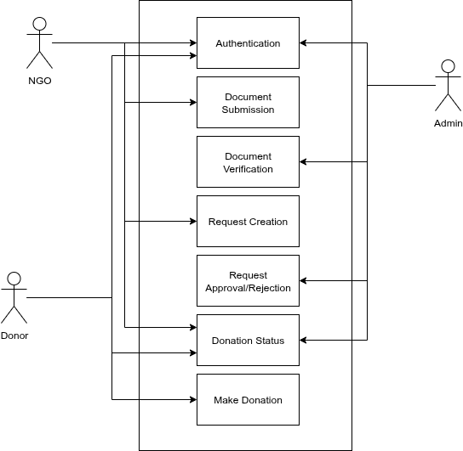
Use Case Diagram

Slide 15
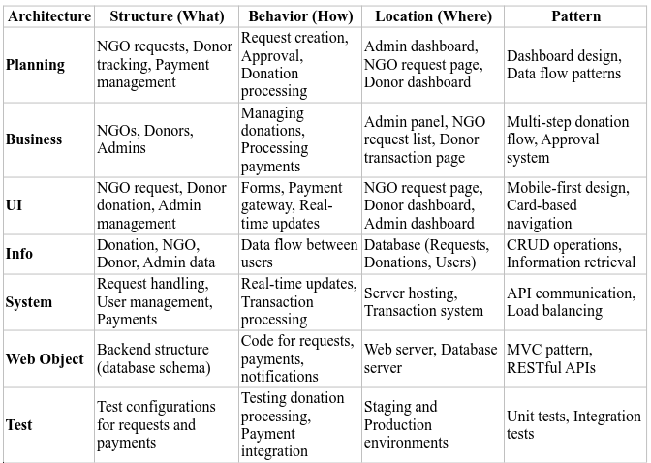
Web Application Architecture Framework (WAAF) Matrix

Slide 16
Interaction Design Guidelines
Consistency:
Use same icons and labels across the platform.
Feedback:
Success messages when donations are successfully made.
Simplicity:
One-click donation process, minimal text.
Visibility:
Clear labels like "Pending" and "Completed".
Error Prevention:
Confirm before donation submission.
Accessibility:
Support for easily accessible, color-coded menus.

Slide 17
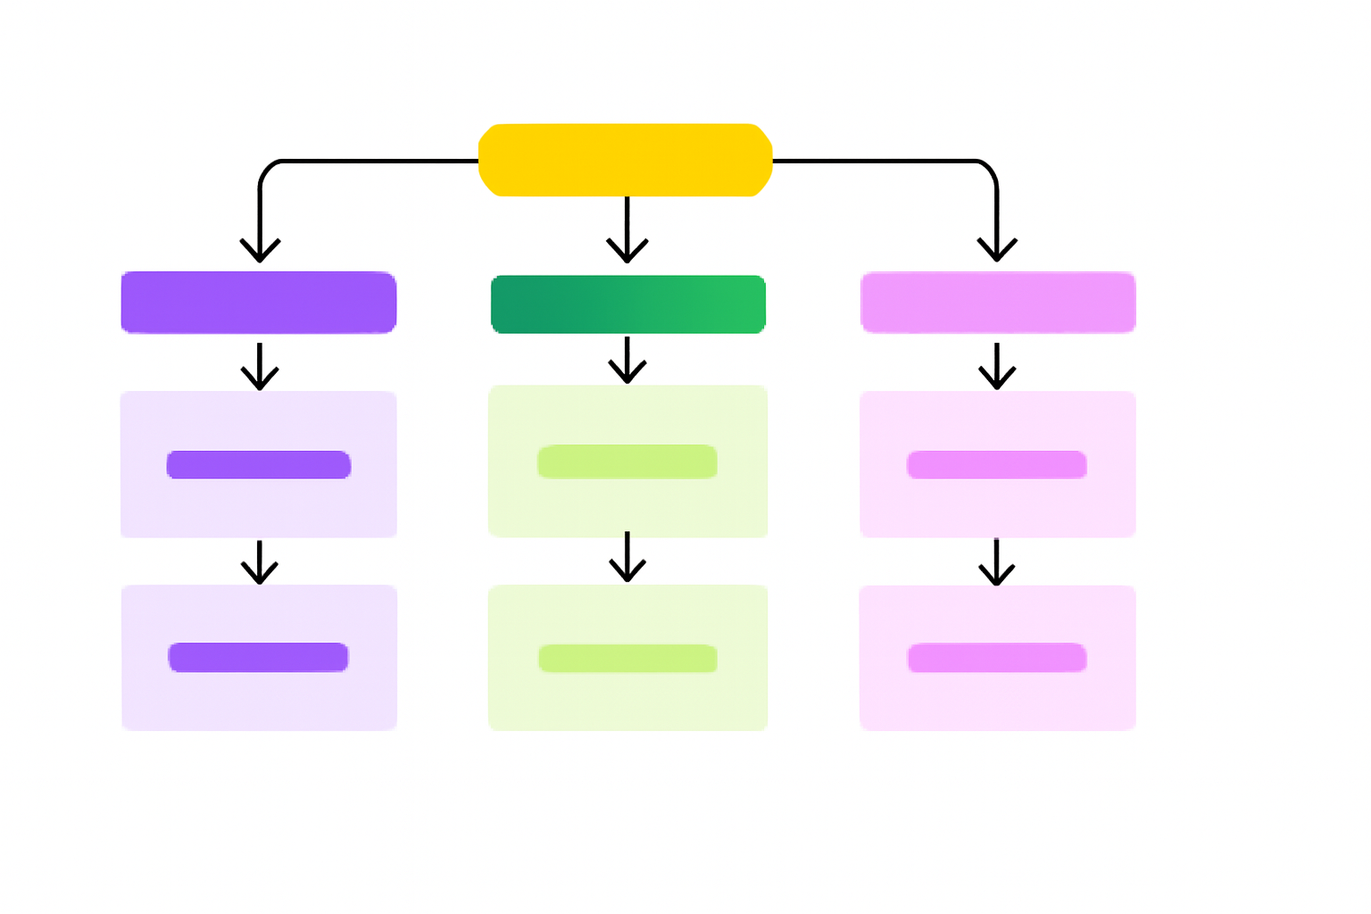
Information Design Structure
Hierarchical Structure:
Clear categories for users (Donors, NGOs, Admins).

Slide 18
Thank You!

